Slide 1
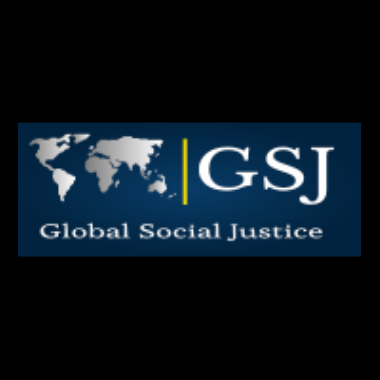

Global Austerity Alert:
Looming Budget Cuts in 2021-25
and Alternatives
Isabel Ortiz and Matthew Cummins
Asia Europe Peoples Forum, 21 May 2021
Social Justice Working Group

Slide 2
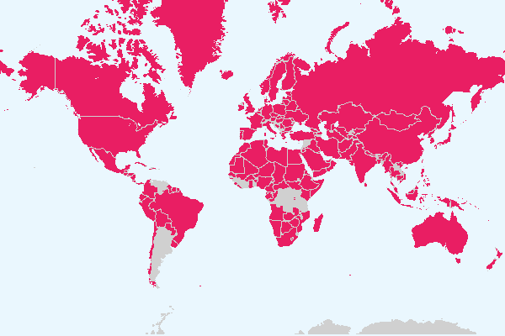
Austerity 2021-22
Countries projected to contract total government expenditure in GDP terms in 2021-22
Source: Ortiz and Cummins, 2021: Global Austerity Alert: Looming Budget Cuts in 2021-25 and Alternative Pathways.
Based on IMF fiscal projections in IMF World Economic Outlook, October 2020.
Notes:
Since the beginning of the 20th century, significant progress has been made: from early steps taken in a number of pioneer countries, the world has seen social protection systems develop at an impressive pace.
At present, most countries have in place social protection schemes anchored in national legislation covering all or most policy areas of social protection, although in some cases these cover only a minority of their populations
Despite progress, large gaps remain in parts of Asia and Africa.

Slide 3
Fiscal Trends 2008-25: Two crises (2008-09 and 2020) followed by long contraction/austerity
Number of countries contracting public expenditure, 2008-25 (as a %GDP)
Source: Ortiz and Cummins, 2021: Global Austerity Alert: Looming Budget Cuts in 2021-25 and Alternative Pathways.
Notes:
Since the beginning of the 20th century, significant progress has been made: from early steps taken in a number of pioneer countries, the world has seen social protection systems develop at an impressive pace.
At present, most countries have in place social protection schemes anchored in national legislation covering all or most policy areas of social protection, although in some cases these cover only a minority of their populations
Despite progress, large gaps remain in parts of Asia and Africa.

Slide 4
Austerity 2021 onwards is bad policy
People suffering unnecessarily
2020 – Fiscal expansion, governments increased public spending to cope with the coronavirus pandemic (emergency health expenditures, fiscal stimulus plans to protect jobs and the economy, temporary social protection programs)
But in 2021, public expenditure austerity cuts are expected in 154 countries, 159 countries in 2022 and the trend continues up to 2025.
The post-pandemic shock appears premature and severe at a time when public support is most needed.
Austerity is bad policy: Countercyclical spending is the only way to enable an inclusive and sustainable post-COVID-19 recovery.
Austerity contracts jobs and economic activity; more public investment is needed.
In 2010-19, austerity policies have increased poverty and inequality. Women were particularly affected, in particular by the cuts in social protection and public services; further, austerity was carried out with the implicit assumption that women would act as the shock absorbers by providing (unpaid) care at home.
Austerity also proved to be a deadly policy, leaving public health systems overburdened, underfunded and understaffed from a decade of austerity—aggravated health inequalities and made populations vulnerable to COVID-19.
Source: Ortiz and Cummins, 2021: Global Austerity Alert: Looming Budget Cuts in 2021-25 and Alternative Pathways.
Notes:
Since the beginning of the 20th century, significant progress has been made: from early steps taken in a number of pioneer countries, the world has seen social protection systems develop at an impressive pace.
At present, most countries have in place social protection schemes anchored in national legislation covering all or most policy areas of social protection, although in some cases these cover only a minority of their populations
Despite progress, large gaps remain in parts of Asia and Africa.

Slide 5
6.6 billion people or 85% of world population will be living under austerity in 2022
Population affected by public expenditure contraction in GDP terms, 2008-25
(in number of persons and as a % of global population)
Source: Ortiz and Cummins, 2021: Global Austerity Alert: Looming Budget Cuts in 2021-25 and Alternative Pathways.
Notes:
Since the beginning of the 20th century, significant progress has been made: from early steps taken in a number of pioneer countries, the world has seen social protection systems develop at an impressive pace.
At present, most countries have in place social protection schemes anchored in national legislation covering all or most policy areas of social protection, although in some cases these cover only a minority of their populations
Despite progress, large gaps remain in parts of Asia and Africa.

Slide 6
Austerity in all regions/areas
Persons impacted by budget cuts in terms of GDP, by income groups and regions (% population)
Income group/region | 2020 | 2021 | 2022 | 2023 | 2024 | 2025
Low income | 43 | 56 | 45 | 31 | 40 | 55
Lower middle-income | 15 | 90 | 83 | 89 | 84 | 85
Upper middle-income | 0 | 48 | 91 | 87 | 67 | 85
High income | 0 | 98 | 95 | 96 | 98 | 57
East Asia & Pacific | 1 | 37 | 96 | 87 | 80 | 90
Europe & Central Asia | 0 | 99 | 89 | 82 | 79 | 75
Latin America & Caribbean | 0 | 81 | 88 | 83 | 27 | 60
Middle East & North Africa | 24 | 70 | 76 | 69 | 70 | 47
North America | 0 | 100 | 100 | 100 | 100 | 11
South Asia | 12 | 98 | 88 | 97 | 99 | 99
Sub-Saharan Africa | 35 | 68 | 50 | 63 | 50 | 69
World | 10 | 72 | 85 | 84 | 76 | 78
Fuente: Ortiz y Cummins, 2021: Global Austerity Alert: Looming Budget Cuts in 2021-25 and Alternative Pathways.
Notes:
Since the beginning of the 20th century, significant progress has been made: from early steps taken in a number of pioneer countries, the world has seen social protection systems develop at an impressive pace.
At present, most countries have in place social protection schemes anchored in national legislation covering all or most policy areas of social protection, although in some cases these cover only a minority of their populations
Despite progress, large gaps remain in parts of Asia and Africa.

Slide 7
The post-pandemic shock is more premature and severe than the one that followed the global financial crisis
Average annual change in government expenditure, 2008-25 (as a %GDP)
Source: Ortiz and Cummins, 2021: Global Austerity Alert: Looming Budget Cuts in 2021-25 and Alternative Pathways.
Notes:
Since the beginning of the 20th century, significant progress has been made: from early steps taken in a number of pioneer countries, the world has seen social protection systems develop at an impressive pace.
At present, most countries have in place social protection schemes anchored in national legislation covering all or most policy areas of social protection, although in some cases these cover only a minority of their populations
Despite progress, large gaps remain in parts of Asia and Africa.

Slide 8
Typical Austerity or Fiscal Consolidation Measures
Need to watch out for austerity/fiscal consolidation measures. A review of 779 IMF country reports published between 2010-19 shows that the most common are:
Eliminating subsidies (fuel, food, agriculture) in 132 countries, despite record-high food prices in many regions.
Wage bill cuts or caps in 130 countries, reducing or freezing the salaries and number of public-sector workers who provide essential services to the population, including education, health and social workers.
Rationalizing and narrow-targeting welfare (“safety nets”) is under consideration in 107 countries, at a time when governments should be scaling up (not scaling down) social protection.
Pension and Social Security Reforms in 105, adjusting benefits and entitlements; as a result, pensioners will receive lower pensions.
Labor flexibilization reforms in 89 countries, reducing employment protections
Health Reforms in 56 countries, reducing capacity to respond to COVID19.
VAT increases on basic goods and services that are consumed by the poor – and which may further contract economic activity – in 138 countries.
Privatizations in 60 countries.

Slide 9
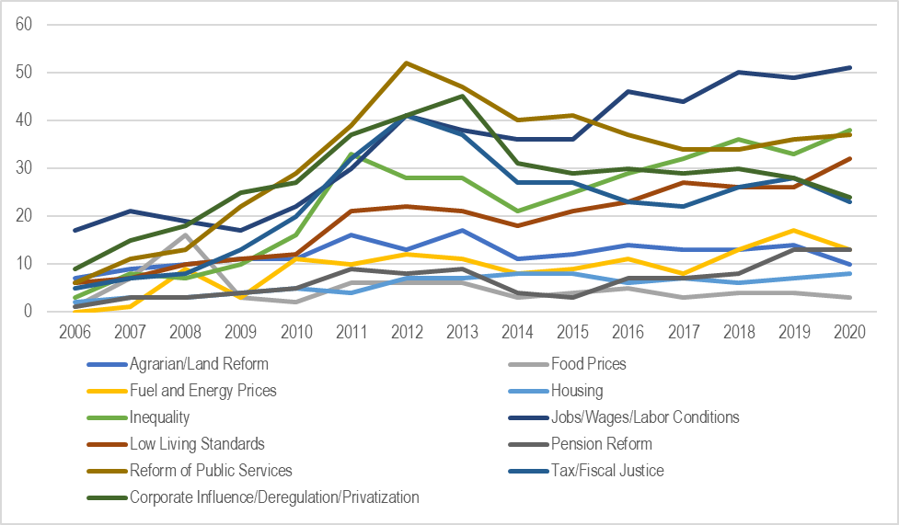
Austerity Cuts with Negative Social Impacts
Must be Avoided
Austerity policies have increased poverty and inequality -in particular for women-, undermined progress on human rights, and sparked social conflict.
  Rising discontent and conflict: Anti-austerity protests in 101 countries, 2006-2020 (in number of protests/year)
Source: Ortiz et al., 2021: World Protests 2006-2020 (forthcoming).
Expenditure and financing decisions that affect the lives of millions of people cannot be taken behind closed doors at the Ministry of Finance
Notes:
Since the beginning of the 20th century, significant progress has been made: from early steps taken in a number of pioneer countries, the world has seen social protection systems develop at an impressive pace.
At present, most countries have in place social protection schemes anchored in national legislation covering all or most policy areas of social protection, although in some cases these cover only a minority of their populations
Despite progress, large gaps remain in parts of Asia and Africa.

Slide 10
There are Alternatives to Austerity: Financing/Fiscal Space Options Exist Even in the Poorest Countries
There are at least eight options, supported by policy statements of the UN and the IFIs. Governments around the world have been applying these financing options for decades, showing a wide variety of revenue choices.
  Increasing tax revenues through progressive sources (avoiding VAT) e.g. income/wealth taxation and corporate taxes including to the financial sector (eg. Mongolia/Zambia/Bolivia, Brazil FTT).
  Increasing social security coverage formalizing those in the informal economy (eg Argentina, Brazil, Tunisia, Uruguay).
  Fighting illicit financial flows.
  Restructuring/reducing debt – more than 60 countries (eg Ecuador, Iceland, Iraq); given high debt levels, important to promote debt forgiveness/relief.
  Aid and transfers (e.g. Global Social Protection Fund).
  Tapping into fiscal and foreign exchange reserves (eg Chile, Norway).
  Adopting a more accommodative macroeconomic framework (e.g. tolerance to some inflation, fiscal deficit).
  Re-allocating public expenditures focus on replacing high-cost and low- social-impact expenditures (eg. defense - Costa Rica, Thailand).
These different alternatives must be discussed openly in national dialogue.
Source: “Fiscal Space for Social Protection: Options to Expand Social Investments in 187 Countries” ILO, UNICEF, UNWOMEN.

Slide 11

#EndAusterity: What to Do
Identify if your government is cutting public expenditures (Annex, OXFAM database and latest IMF country reports).
State alternative demands for post-pandemic recovery (e.g. increase budget in education, health, social protection, water supply, public transport etc)
Call for national public social dialogue – Timing is of the essence, meaningful national dialogue with representative partners can be done quickly. It is best to do it at the time of the public budget design and/or budget approval.
Carry out a rapid and timely assessment of the social impacts of the different policy options and financing
alternatives
Agree optimal policies through national
social dialogue with representative trade
unions, employers, CSOs and other
relevant stakeholders
There is a global campaign #EndAusterity
with more than 500 organizations - join!
Source: Ortiz and Cummins, 2021: Global Austerity Alert: Looming Budget Cuts in 2021-25 and Alternative Pathways.
Notes:
Since the beginning of the 20th century, significant progress has been made: from early steps taken in a number of pioneer countries, the world has seen social protection systems develop at an impressive pace.
At present, most countries have in place social protection schemes anchored in national legislation covering all or most policy areas of social protection, although in some cases these cover only a minority of their populations
Despite progress, large gaps remain in parts of Asia and Africa.

Slide 12
THANK YOU
REFERENCES:
Ortiz and Cummins (2021) Global Austerity Alert: Looming budget cuts in 2021-25 and alternative pathways. IPD Global Social Justice, ITUC, PSI, AWC, BWP and TWN.
Ortiz, Chowdhury, Duran, Muzaffar and Urban (2019) Handbook on Fiscal Space for Social Protection: Assessing Financing Options Geneva and New York: ILO and UNWOMEN
Ortiz, Cummins and Karunanethy (2017) Fiscal Space for Social Protection: Options to Expand Social Investments in 187 Countries Geneva and New York: ILO and UNWOMEN

