Slide 1
People’s Charter for
ASEM Parliamentarians

Slide 2
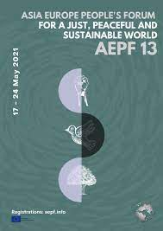
Every person on this planet shares a common humanity.
We all want our children to grow up healthy, to have a good education, have decent work, drink clean water, breathe clean air and live in peace.

Slide 3
Our governments’ have deflected progressive calls to protect the planet and protect its people.
We all need urgent and people centred collective and national responses for our common futures.

Slide 4
Every person on this planet shares a common humanity.
We all want our children to grow up healthy, to have a good education, have decent work, drink clean water, breathe clean air and live in peace.

Slide 5
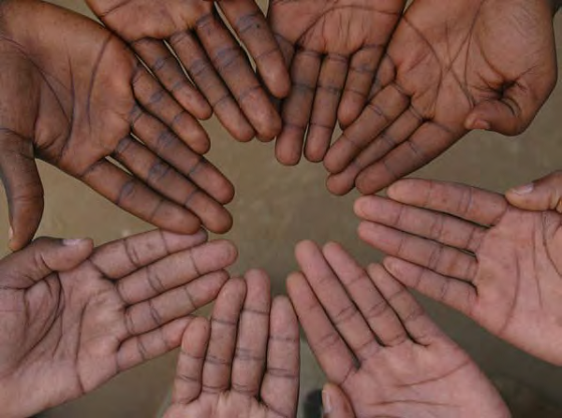
Today, we call on our Governments to work with citizens, including poor, excluded and marginalised people - including migrant and refugee peoples - to develop and implement policies that will lead to a just, equal, inclusive and sustainable Asia and Europe, and more accountable and democratic institutions – based on respect for gender equality, our environment and fundamental human rights.

Slide 6
To do this, as citizens, organisations and movements endorsing the People’s Charter, we call upon Parliamentarians and Governments to develop legislation and mobilise the resources for the following:

Slide 7
Universal, comprehensive and legislated social protection

Slide 8
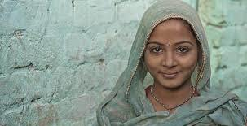

Slide 9
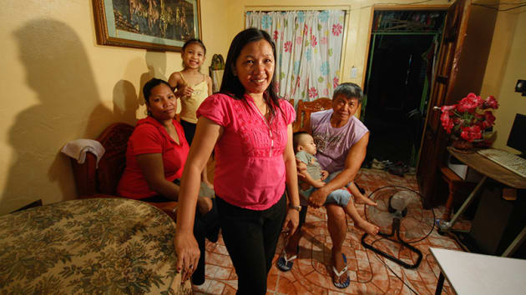

Slide 10
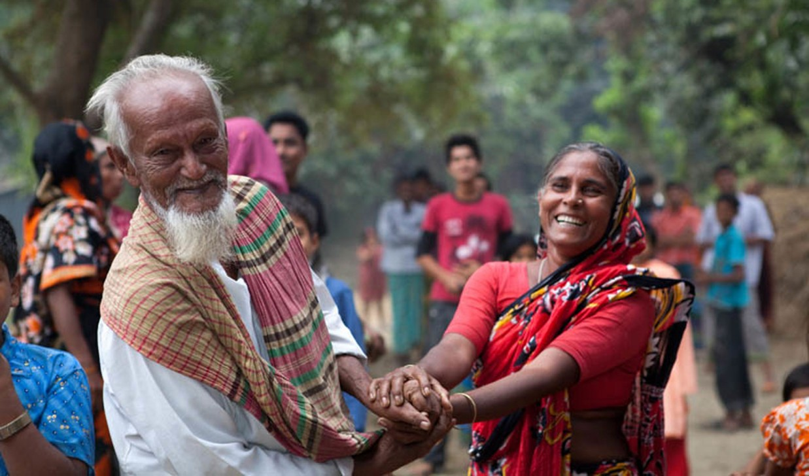

Slide 11
Climate Justice and Just Transitions

Slide 13
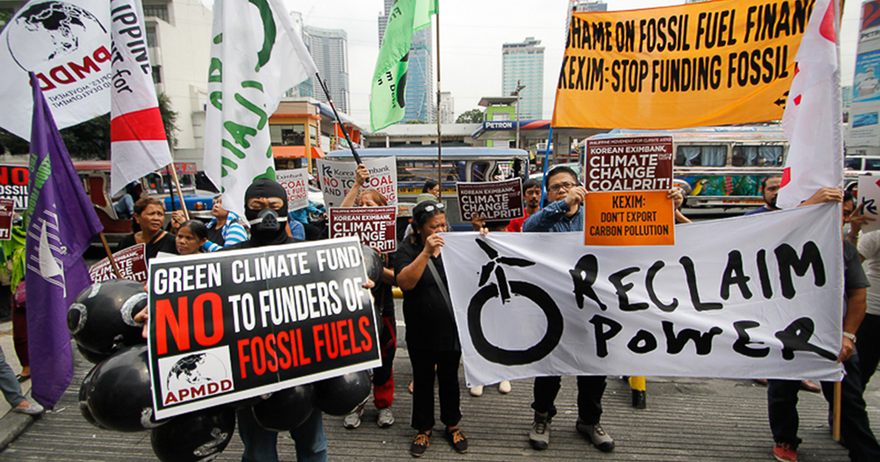

Slide 14
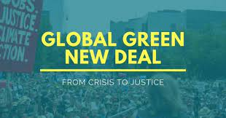

Slide 15
Fair, Just and Sustainable Financial systems

Slide 17
Now we have a common need to build a just, equal, inclusive and sustainable Asia and Europe, and more accountable and democratic institutions – based on respect for gender equality, our environment and fundamental human rights.
A People’s Charter is essential for our common futures - to take us all closer to a just, equitable, resilient, post-carbon, sustainable world.

Slide 18
We commit to actively lobby and engage with Parliamentarians and elected representatives and decision makers to make this become a lived reality in our lifetimes.
This is our People’s Charter and we pledge to work with Parliamentarians, wherever possible, to enable this to be our common, lived reality.

