Slide 1
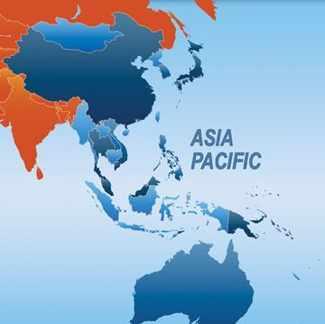
SECURITY IN ASIA PACIFIC (2018 – 2021): ISSUES and RECOMMENDATIONS
Asia – Europe People's Forum 2021
By Nguyen Bich Ngoc

Slide 2
Content
I. Regional context in Asia Pacific
II. Regional security: Key issues
III. Implications for Asia – Europe security
IV. Recommendations: What should be done?

Slide 3
I. REGIONAL CONTEXT IN ASIA PACIFIC
1. Intensification of major powers' competition
2. Deterioration of multilateralism and international law
3. Complexity of conventional and non-conventional security challenges

Slide 4
I. REGIONAL SECURITY: KEY ISSUES
CONVENTIONAL SECURITY ISSUES
1. Territorial disputes
Territorial dispute between India and China
South China Sea
Other disputes in the region
2. Arms control
Nuclear issue in North Korea

Slide 5
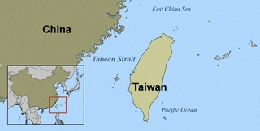
I. REGIONAL SECURITY: KEY ISSUES

Slide 6
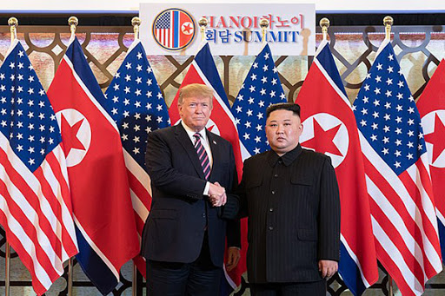
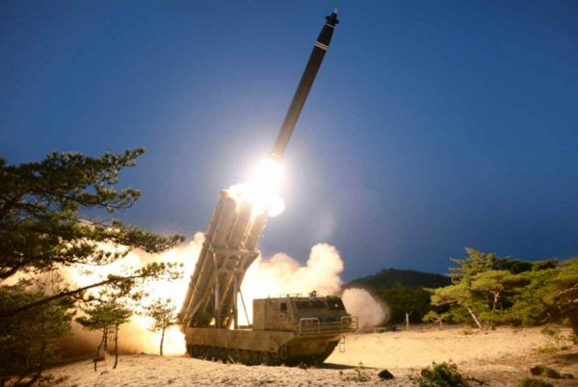
I. REGIONAL SECURITY: KEY ISSUES

Slide 7
I. REGIONAL SECURITY: KEY ISSUES
CONVENTIONAL SECURITY ISSUES
1. Territorial disputes
Focus: South China Sea

Slide 8
SOUTH CHINA SEA DISPUTE

Slide 9
SOUTH CHINA SEA DISPUTE
2013
2014
2015
2016
2017
2018
2019
2020
2021
China accelerated and completed reclaimation
China rejected Permanent Court Award
China's 3 warfares (public opinion, psychological, legal warfares)
2019: Vanguard Bank (Vietnam)
2020: China's 35 drills in SCS
2021: China passed Coast Guard Law and sent many ships to Philippines
China proposed to restart the COC negotiation

Slide 10
SOUTH CHINA SEA DISPUTE
Other countries' responses to China's assertiveness
In 2020 many countries filed note verbales to the United Nations to reject China's sweeping claims in SCS, including Philippines, Malaysia, Vietnam, Indonesia, Australia, US, France, UK and Germany (E3)
Freedom of navigation operations (FONOP) were carried out by the US, France and UK
Call for upholding of international law, particularly the UNCLOS 1982

Slide 11
I. REGIONAL SECURITY: KEY ISSUES
NON-CONVENTIONAL SECURITY ISSUES
1. Pandemic
2. Water security
3. Climate change
4. Cybersecurity
5. Terrorism and extremism

Slide 12
I. REGIONAL SECURITY: KEY ISSUES
1. PANDEMIC
Most serious outbreak in Asia Pacific, particularly India and Southeast Asia in 2021
Southeast Asia: 3 639 268 cases
India: 24 mil. Cases
(Source: ASEAN Health Sector)

Slide 13
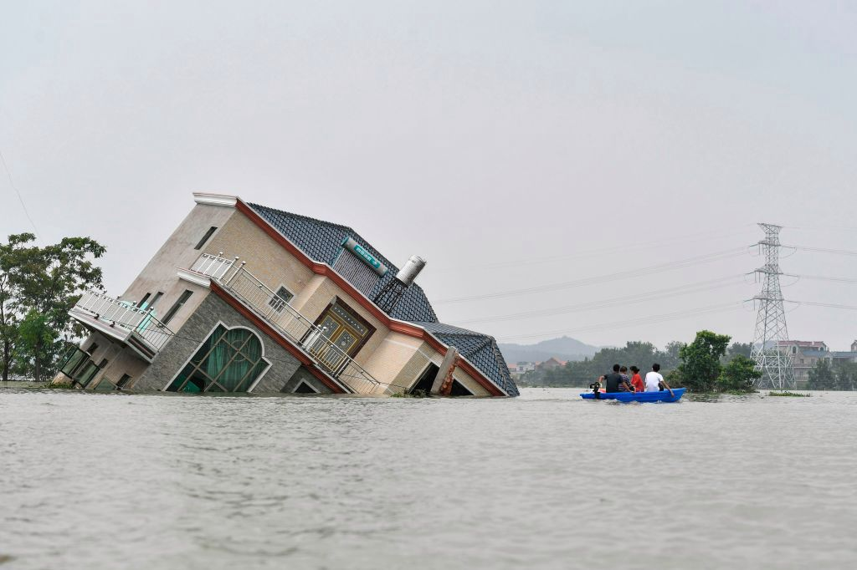
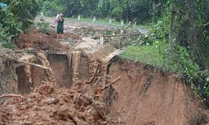
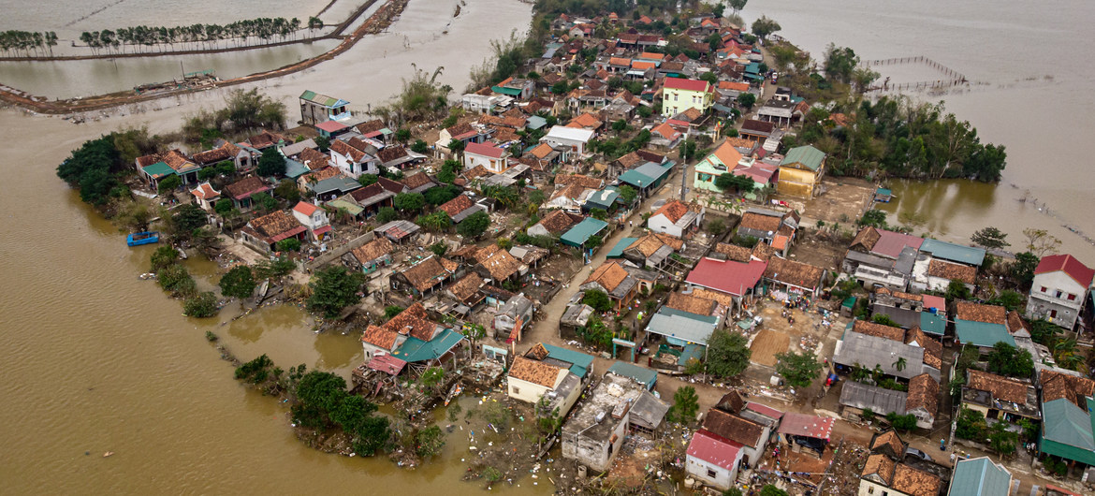
I. REGIONAL SECURITY: KEY ISSUES
3. CLIMATE CHANGE
Extreme weather and natural disasters

Slide 14
I. REGIONAL SECURITY: KEY ISSUES
NON-CONVENTIONAL SECURITY ISSUES
Focus: Mekong issue

Slide 15
Mekong issue

Slide 16
Mekong issue
Upstream dams and climate change cause more and more serious consequences to the Mekong delta
In 2020 the most severe drought in history of the subregion
The most serious salt intrusion from the sea in the last 100 years
Precipitation in Mekong delta of Vietnam decreased by 30 – 40% of the yearly average
The water level in Tongle Sap (Cambodia) went down by 2.5 times of the average.

Slide 17
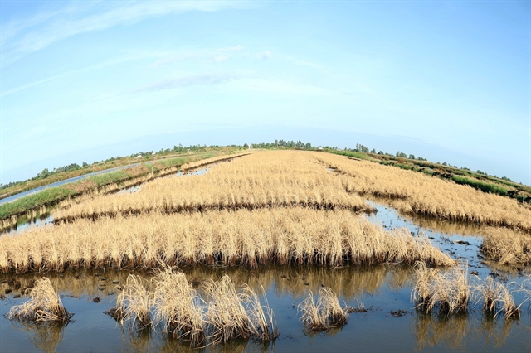
Mekong issue

Slide 18
Mekong issue
MULTILATERAL MECHANISMS IN THE MEKONG SUBREGION
Mekong River Commission (MRC)
ACMECS
Mekong – Lancang Cooperation (MLC, launched by China in 2016)
Japan incorporated FOIP to the Mekong since 2017
Mekong – Han River Declaration in 2019 (Republic of Korea)
The US upgraded LMI to Mekong – US Partnership in 2020

Slide 19
III. Implications for Asia – Europe security
1. Escalation of tension
2. Danger to human security
3. Hindrance to post-Covid-19 economic recovery
4. International law

Slide 20
III. Implications for Asia – Europe security
Security of Asia and Europe has become more and more intertwined
Territorial disputes: Nagorno-Karabakh, Israel – Palestine
Arm control: Withdrawal from INF, Treaty on Open Skies, Iran nuclear issue
Climate change, Terrorism, Cybersecurity

Slide 21
IV. Recommendations
What should be done?
1. National level
2. Regional level
3. Inter-regional level

Slide 22
IV. Recommendations
What should be done?
1. Foster constructive dialogues between people's organizations and state agencies in policy making
2. Raise awareness of people of security challenges and the connection of Asian and European security (undivided security)
3. Enhance cooperation between people's organizations and multilateral mechanisms in both regions
4. Stronger call for international law and multilateralism based on UN Charter

Slide 23
CONCLUSION
Peace movement and cooperation are critical for people's life
Strengthen multilateralim and international law

Slide 24
THANK YOU FOR YOUR ATTENTION!

