Slide 1
Making houses affordable to the low income people
LAJANA MANANDHAR
LUMANTI SUPPORT GROUP FOR SHELTER
7th April 2021

Slide 2
SCENARIO
Fast growing urban population
10% of urban population lives in informal settlements
40% of urban population lives in rental housing
40% achievement in urban reconstruction
Pressure for affordable housing

Slide 3
Successful approaches
Community led. Organising women through savings and cooperatives for creating community fund.
Partnership with stakeholders including LGs and Commercial Banks
Leveraging resources from the local governments
Technical and Financial Assistance

Slide 4
Achievements
Successful relocation. Kirtipur housing project
Introduction of cooperative model. Pokhara housing project.
Low Income Rental Housing, Lalitpur
Slum upgrading
Recovery and reconstructions after 2015 earthquake
Affordable and incremental housing in the urban areas
Decent Poor housing

Slide 5
Relocation: Kirtipur Housing
Features
Vishnumati Link Road project affected 44 families relocated
15 years long housing loan
Collective ownership of land

Slide 6
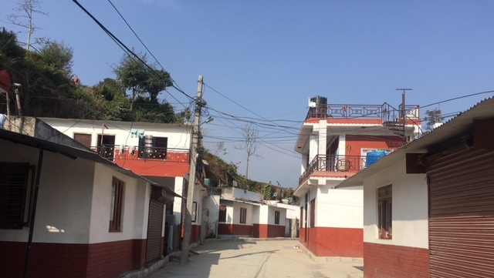
Cooperative model: Pokhara Housing
76 rental families owned housing
7 years period housing loan
LG investment in infrastructure

Slide 7
Rental Housing
24 rental units
Access private toilets
Rainwater harvesting
Solar lights
Committee of rental families
24 families living in Rental House in Dhobighat, Lalitpur

Slide 8
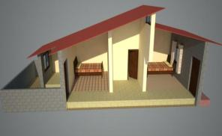
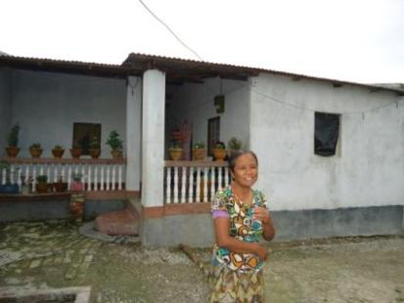
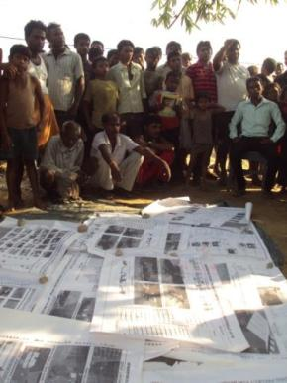
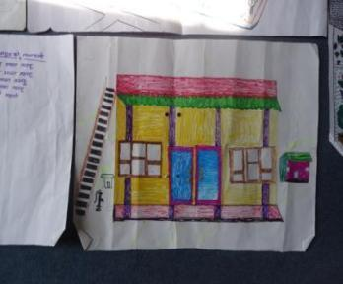
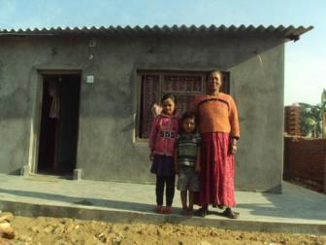
Slum upgrading
Partnership with municipalities
Loan for housing with low interest
Municipality invests for infrastructure

Slide 9
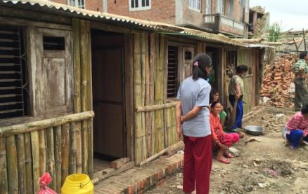
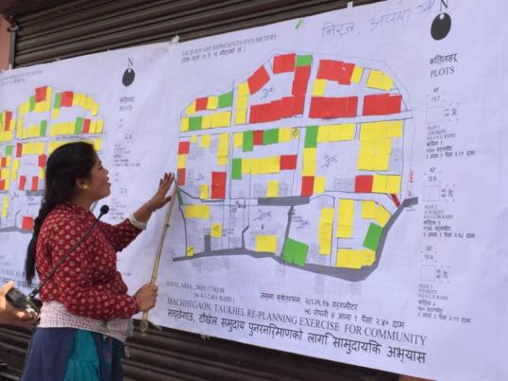
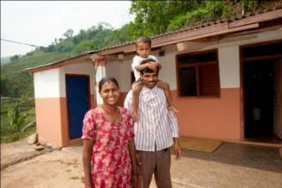
Recovery and reconstruction
Advocacy and negotiations with local governments
Communal procurement
Cluster based reconstruction
Use of reusable salvaged materials
Support for infrastructure and land pooling

Slide 10
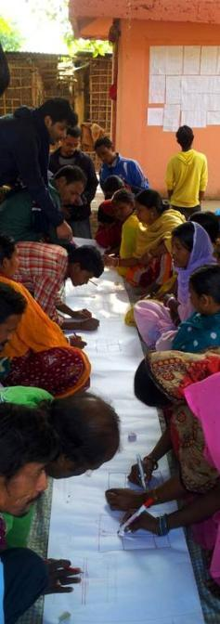
Affordable and incremental housing in the urban areas
Cooperatives and banks provide housing loan
Technical assistance
Community led planning
LGs investment in infrastructure

Slide 11
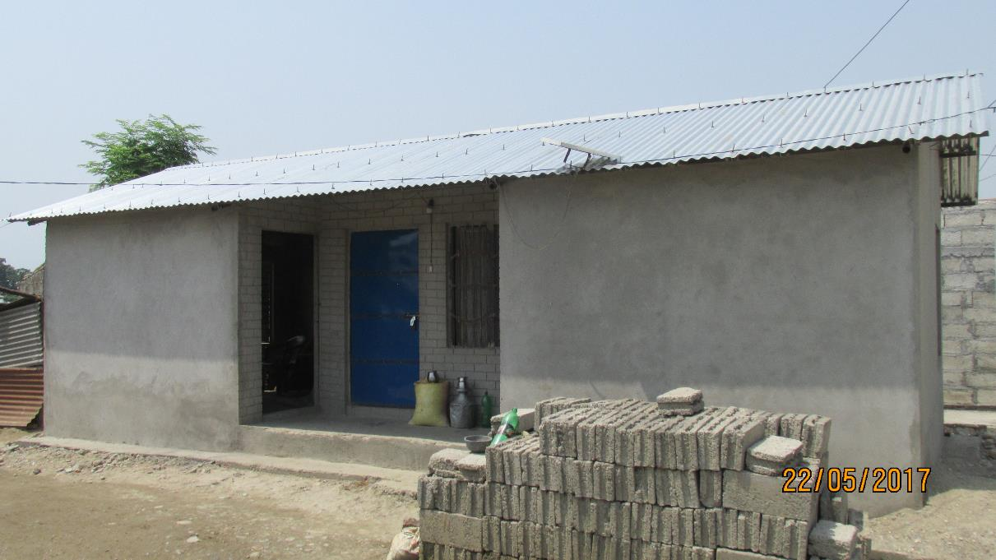
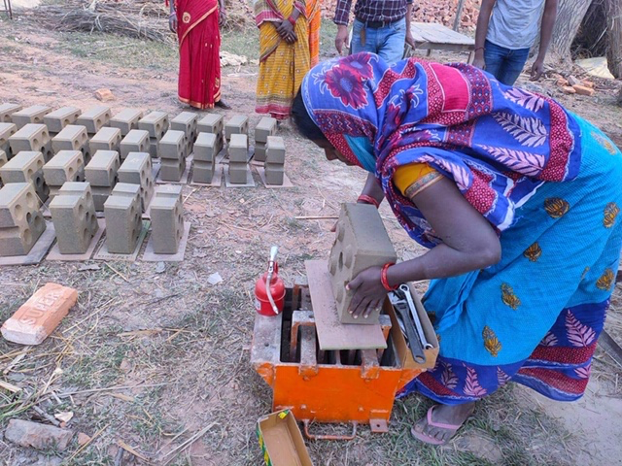
Decent poor housing
Community selects the most vulnerable
Approval from the local government
Focus on repair and maintenance
Maximum grant support is Rs. 50,000 as per need
About 130 families benefitted

Slide 12
Thank You

