Slide 1
GLOBAL
Small-scale Fishing and Food Sovereignty
By Herman Kumara, NAFSO and WFFP
10 November 2020

Slide 2
THE ROLE OF FISHERS IN FOOD SOVEREIGNTY What can they deliver?
Food security and nutrition
Contribution to local economy development
Lifestyles, rituals and daily practices surrounding ﬁsh consumption and ﬁshing - deeply integrated into the cultures of communities
Fish is food and food for life

Slide 3
THE IMPACT OF THE PRESENT CRISIS ON FISHERS IN ASIA AND IN SRI LANKA How will SSFs be able to deliver when they are in crisis situation themselves?
Pre-COVID-19: Failing food and fishing systems
Ecological externalities: Cyclones, Salt Water Intrusion, Increase Coastal Hazards, Sea Quakes, Tsunamis, Sea Pollution
Exclusion of Marine and Coastal Communities : Marine Protected Areas, Industrial Zones
Inequitable access to resources and markets, and to health, education and other social services
Enforcement of Maritime Security: KRA Canal in Thailand, Port City in SL,
Infrastructure development, Ports [India, Sri Lanka] and construction of commercial cities through reclamation projects [SL- Port City, Indonesia- Pakistan-New Dubai]

Slide 4
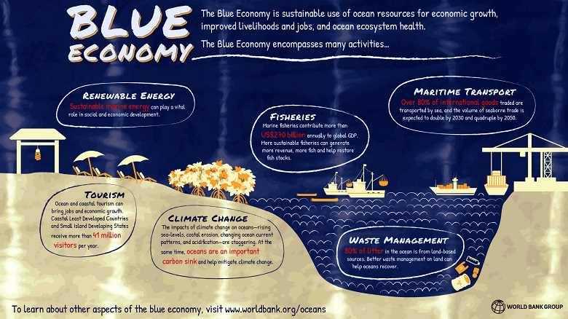
UN/WB/FAO /IFI’s/ Coastal States/ MNCs – BE Adopted

Slide 5
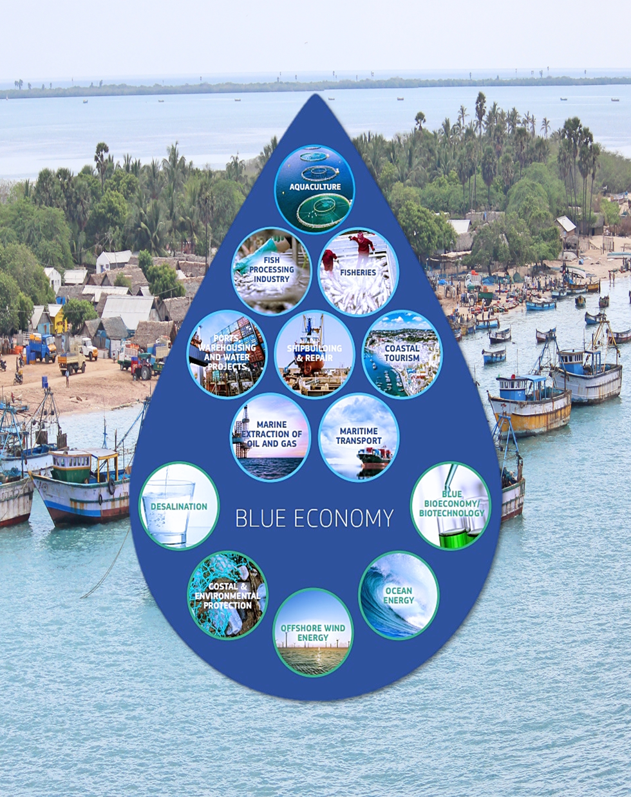
Coasts and Fishers in the Era of Blue Economy

Slide 6
4 SECTORS of Blue Economy
Legal use of Resources: Fishing in EEZ, Aquaculture, Fishing Processes, Maritime Transportation,
Coastal Development: Infrastructure Dev., Tourism, Port Developments, Industrial Zones,
Marine Extraction: Oil & Gas, Sea Bed Mining,
Militarization: Fake Islands, Canals, Geo Political military conflicts,

Slide 7
Externalisation of Marginalised Communities specially Coastal and Marine Communities (Mokeshkhali Island, Gujarat Coast)
Self-organised Women Fish Vendors are being removed from the Supply and Value Chain (India, Sri Lanka,)
Irreversible Damage to Coastal and Marine Ecosystems such as Estuaries, Salt marshes, Lagoons, Mudflats, Mangroves, and other potential ecosystems (Indonesia, India, Sri Lanka, Pakistan, Thailand, Bangladesh)
Trade and fiscal deficit leading to devaluation of currency and inflation. (Sri Lanka, Indonesia, India)
Displacement of people due to dispossession of resources and denial of customary rights to ocean and coastal commons. (Indonesia, India, Sri Lanka, Thailand, Bangladesh)
Militarisation and Security Surveillance of the Ocean and Coast(Indonesia, Sri Lanka, India, Bangladesh, Thailand)

Slide 8
THE IMPACT OF THE PRESENT CRISIS ON FISHERS IN ASIA AND IN SRI LANKA How will SSFs be able to deliver when they are in crisis situation themselves?
With COVID-19:
Sri Lanka
Closure of harbours and fish markets
Restrictions on the movement of fishers and fishworkers
Food insecurity in protracted crisis
Women fish vendors and traders lost their livelihoods

Slide 9
FISHERS' RESPONSES TO THE CRISIS What to do to be able to deliver?
Advocacies as a social movement of WFFP: International Guidelines on SSF; Framework for Action for Food Security in Protracted Crisis
Studies on emerging consumer behaviours
Possible Resistance and Alternatives under UN Systems: UN Food Systems Summit
SSF response to Blue Economy based on SSF Guidelines, towards Sustainable Blue Economy

Slide 10
What is our Response to Crisis?
Rethinking Industrialization- Use of Local Knowledge, Realize at multiple levels of involvement of people including women, in decision making processes,
People need to rethink what is the relationship between Land and the Sea, & question about current development, Geo Politics,
Social Movements need to set the direction for the sustenance, build human dignity through social transformation process,
Building alliances within and among food producer groups, oppressed communities, such as WFFP, LVC, Pastoralist groups etc.
Social Movements plan for Global Green/ Blue Global PPT,

Slide 11
https://www.oecd.org/coronavirus/policy-responses/policy-implications-of-coronavirus-crisis-for-rural-development-6b9d189a/#figure-d1e332

Slide 12
Social Protection of Fishers and Development of the Geneva Declaration on Human Rights at Sea: FUNDAMENTAL PRINCIPLES
1. Human rights apply at sea to exactly the same degree and extent that they do on land.
2. All persons at sea, without any distinction, are entitled to their human rights.
3. There are no maritime specific rules allowing derogation from human rights.
4. All human rights established under treaty and customary international law must be respected at sea.
The protection of human rights at sea rest on the following four fundamental principles:
https://www.humanrightsatsea.org/wp-content/uploads/2019/04/HRAS_
GENEVA_DECLARATION_ON_HUMAN_RIGHTS_AT_SEA_5_April_2019
_Version_1_LOCKED.pdf

