Slide 1


Equitably ending fossil fuel extraction
Greg Muttitt, IISD
Presentation to AEPF
18 May 2021

Slide 2
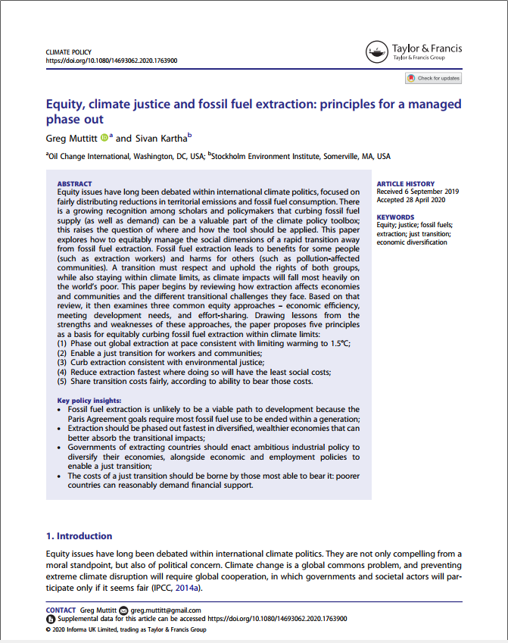
https://doi.org/10.1080/14693062.2020.1763900
Equitably ending fossil fuel extraction - 18 May 2021

Slide 3
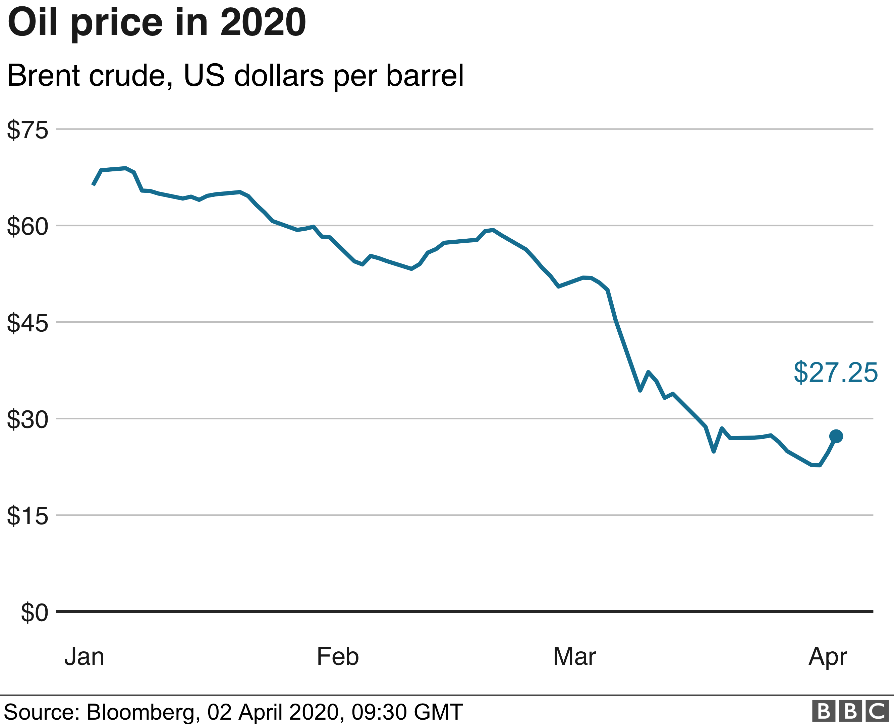


Equitably ending fossil fuel extraction - 18 May 2021

Slide 4
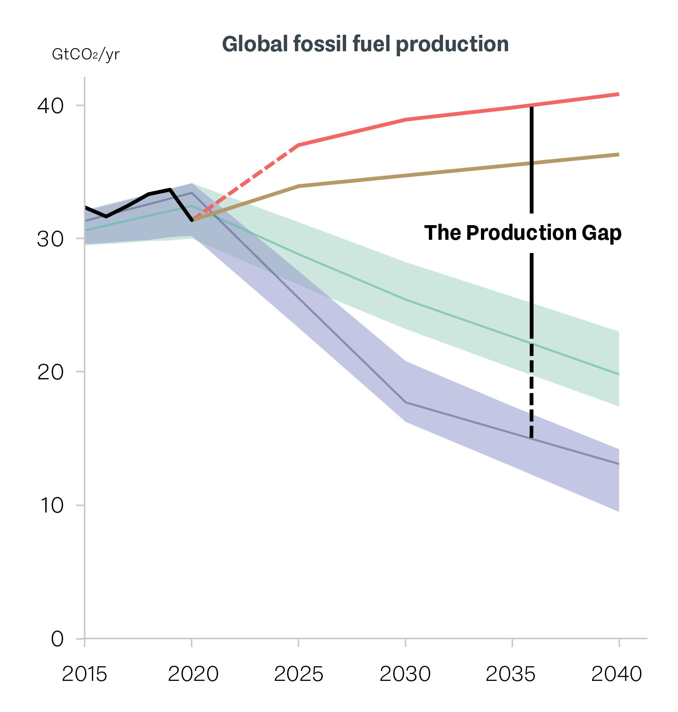



The production gap
Countries’ production plans & projections
Production implied by countries’ climate pledges
Production consistent with limiting warming to 2°C
Production consistent with limiting warming to 1.5°C
https://productiongap.org/
Equitably ending fossil fuel extraction - 18 May 2021

Slide 5
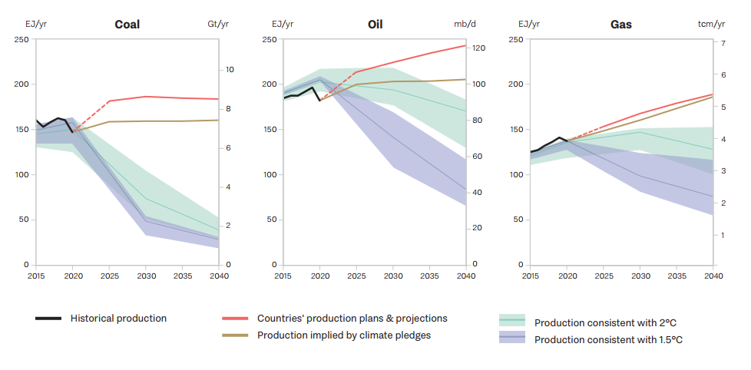
The production gap
Equitably ending fossil fuel extraction - 18 May 2021

Slide 6
Effort sharing
This Agreement will be implemented to reflect equity and the principle of common but differentiated responsibilities and respective capabilities, in the light of different national circumstances.
Paris Agreement, Article 2.2
Equitably ending fossil fuel extraction - 18 May 2021

Slide 7
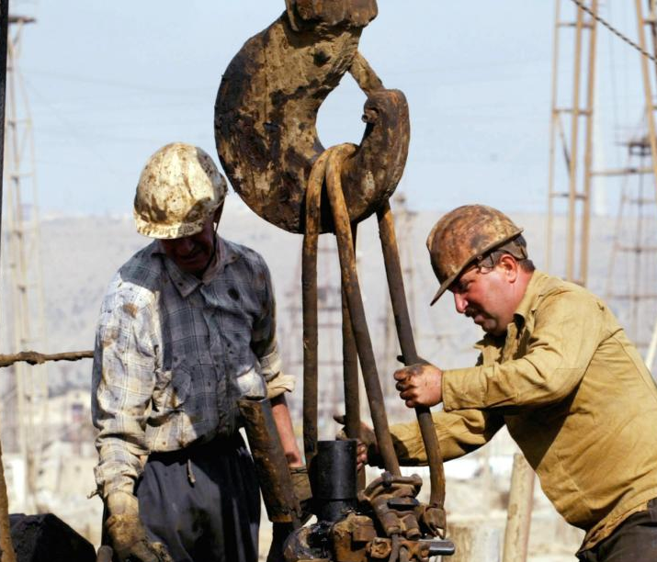
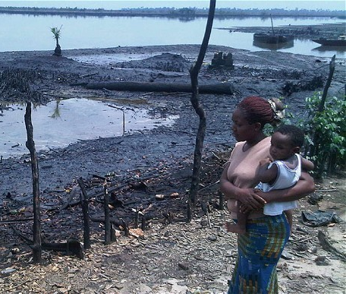
Benefit or harm?
Equitably ending fossil fuel extraction - 18 May 2021

Slide 8
Just transition
Sound investments in low-emission and job-rich sectors;
Social dialogue and democratic consultation of social partners (trade unions and employers) and other stakeholders;
Research and early assessment of the social and employment impacts of climate policies;
Training and skills development to support affected workers in obtaining decent employment in new sectors;
Social protection for workers and communities disrupted by job losses and displacement (e.g. social insurance, employment guarantees, public works employment);
Local economic diversification plans that support decent work and enable communities to thrive in the transition.
https://www.ituc-csi.org/ituc-frontlines-briefing-climate
Equitably ending fossil fuel extraction - 18 May 2021

Slide 9
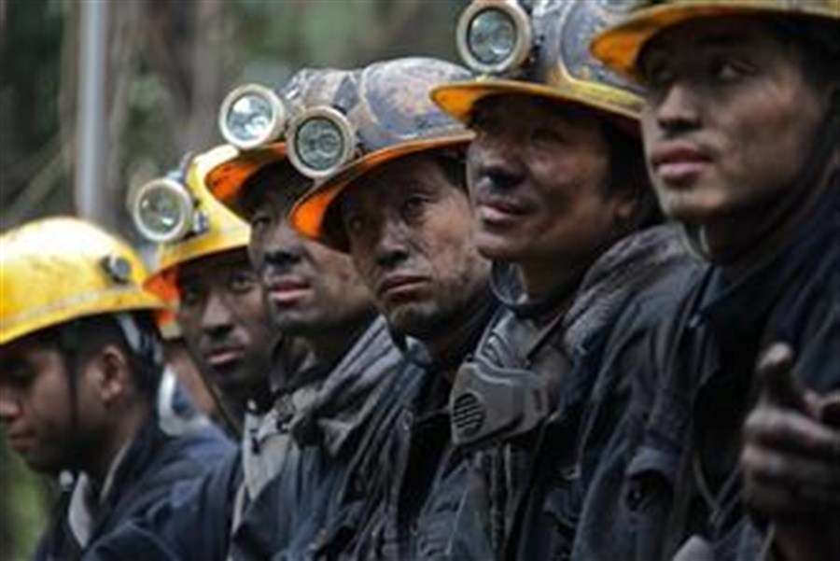

Whose employment rights?
“There are no jobs on a dead planet”
International Trade Union Confederation
Equitably ending fossil fuel extraction - 18 May 2021

Slide 10
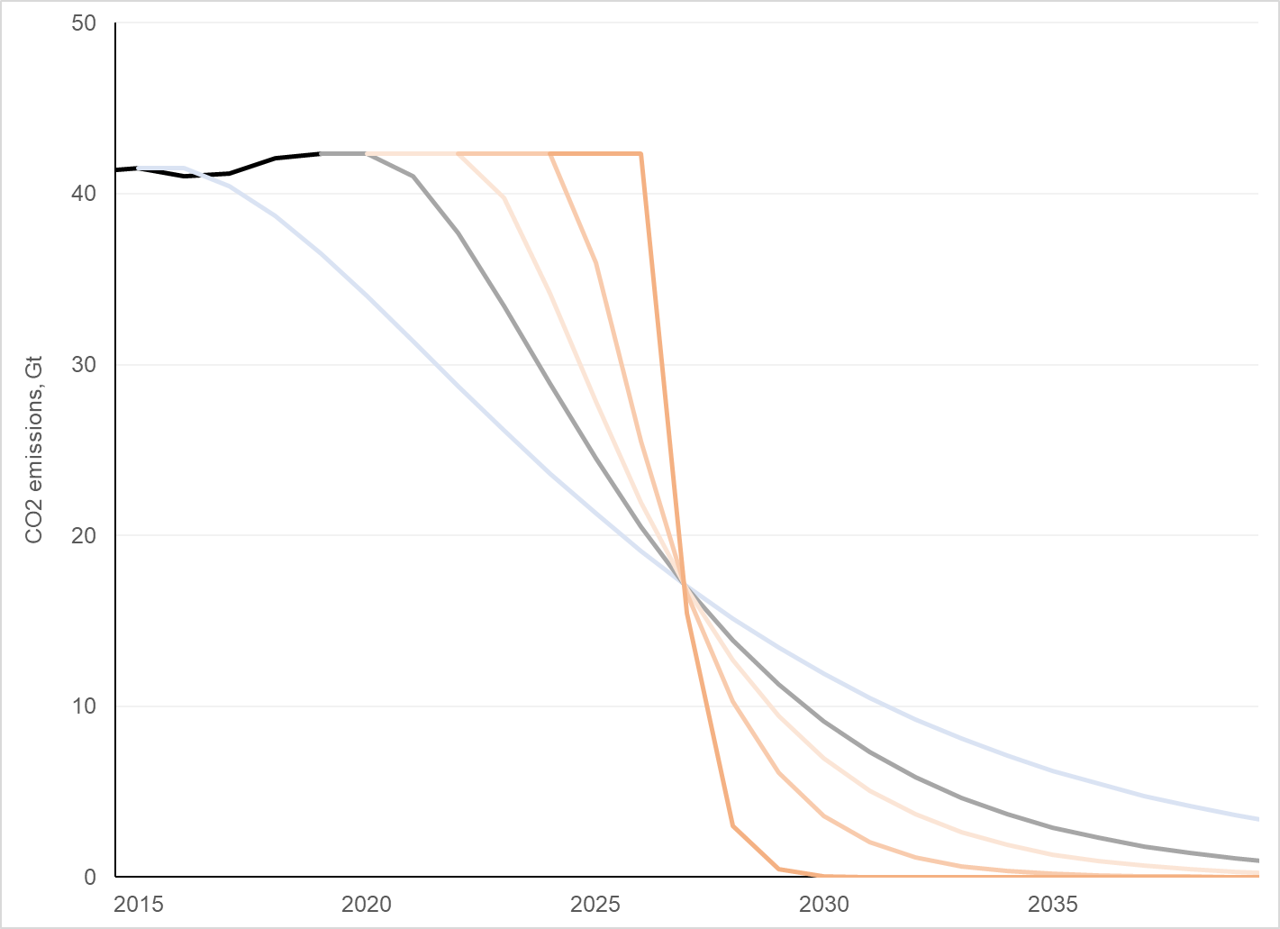
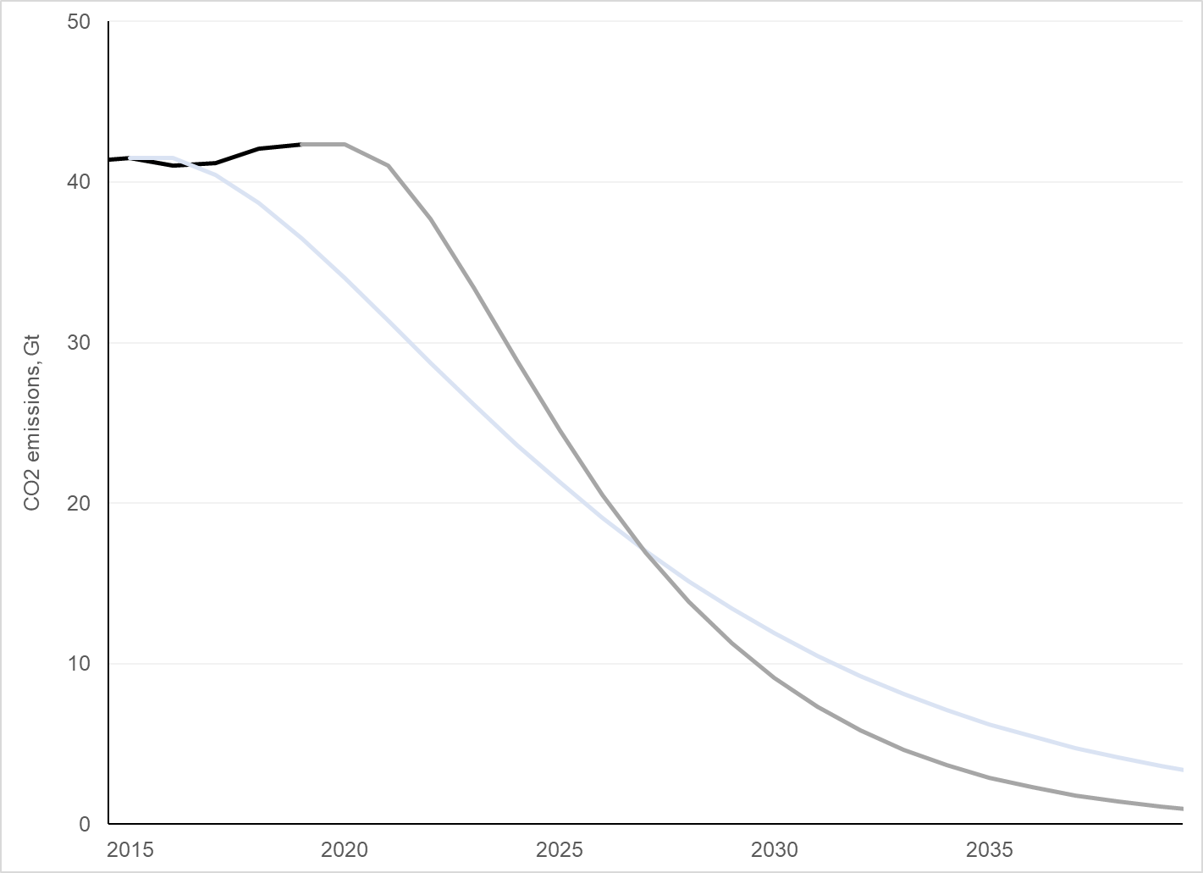
Dangers of delay
Based on: https://folk.universitetetioslo.no/roberan/t/global_mitigation_curves.shtml
Equitably ending fossil fuel extraction - 18 May 2021

Slide 11
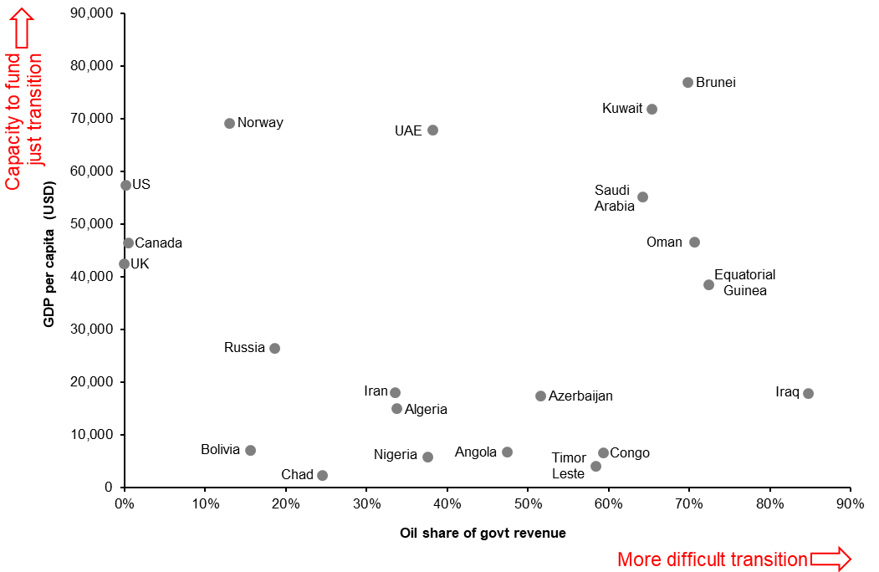
Just transition challenges: oil
Equitably ending fossil fuel extraction - 18 May 2021

Slide 12
Principles for a managed phaseout
Phase out global extraction at pace consistent with limiting warming to 1.5°C;
Enable a just transition for workers and communities;
Curb extraction consistent with environmental justice;
Reduce extraction fastest where doing so will have the least social costs;
Share transition costs fairly, according to ability to bear those costs.
Equitably ending fossil fuel extraction - 18 May 2021

